Slide 1

(Systematic Voters’ Education and Electoral Participation)

Slide 2
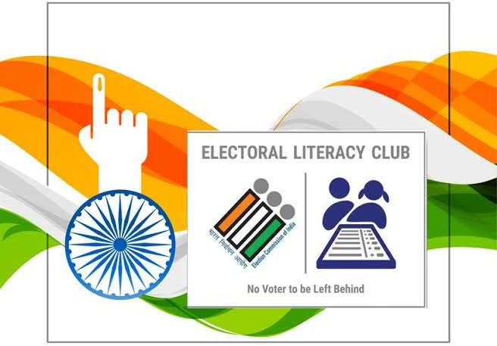

Slide 3
RJ : District Wise On-boarding Status, since 8th -15th Sept 2026
Sl. No. | District | Estimated no of ELCs | Approved ELC | No. of Pending Request | Pending at DEO | Pending at ERO | TotalELCs | Achievement % as on 14th Sept 2026
8 | Bharatpur | 962 | 58 | 826 | 343 | 483 | 884 | 91.89%
32 | Pali | 828 | 373 | 387 | 366 | 21 | 760 | 91.79%
1 | Ajmer | 1056 | 5 | 918 | 616 | 302 | 923 | 87.41%
40 | Tonk | 805 | 440 | 258 | 138 | 120 | 698 | 86.71%
16 | Dholpur | 669 | 385 | 172 | 3 | 169 | 557 | 83.26%
27 | Karauli | 839 | 0 | 645 | 189 | 456 | 645 | 76.88%
12 | Chittorgarh | 739 | 524 | 30 | 3 | 27 | 554 | 74.97%
31 | Nagaur | 1002 | 287 | 401 | 173 | 228 | 688 | 68.66%
33 | PHALODI | 481 | 298 | 8 | 3 | 5 | 306 | 63.62%
34 | Pratapgarh | 409 | 213 | 38 | 0 | 38 | 251 | 61.37%
39 | Sirohi | 436 | 257 | 7 | 3 | 4 | 264 | 60.55%
37 | Sawaimadhopur | 841 | 0 | 464 | 90 | 374 | 464 | 55.17%
36 | SALUMBER | 269 | 0 | 148 | 79 | 69 | 148 | 55.02%
15 | Deeg | 538 | 239 | 55 | 1 | 54 | 294 | 54.65%
2 | Alwar | 1242 | 447 | 216 | 18 | 198 | 663 | 53.38%
13 | Churu | 1433 | 606 | 148 | 0 | 148 | 754 | 52.62%
4 | Banswara | 801 | 317 | 91 | 49 | 42 | 408 | 50.94%
14 | Dausa | 1120 | 0 | 552 | 41 | 511 | 552 | 49.29%
10 | Bikaner | 1351 | 326 | 339 | 26 | 313 | 665 | 49.22%
35 | Rajsamand | 610 | 71 | 208 | 104 | 104 | 279 | 45.74%
11 | Bundi | 559 | 0 | 240 | 71 | 169 | 240 | 42.93%
20 | Hanumangarh | 1187 | 203 | 303 | 118 | 185 | 506 | 42.63%
18 | Dungarpur | 681 | 0 | 262 | 133 | 129 | 262 | 38.47%
41 | Udaipur | 1179 | 0 | 437 | 365 | 72 | 437 | 37.07%
26 | Jodhpur | 1808 | 0 | 587 | 297 | 290 | 587 | 32.47%
9 | Bhilwara | 992 | 241 | 69 | 31 | 38 | 310 | 31.25%
29 | Kota | 1014 | 218 | 75 | 16 | 59 | 293 | 28.90%
24 | Jhalawar | 578 | 108 | 55 | 20 | 35 | 163 | 28.20%
7 | Beawar | 540 | 0 | 149 | 0 | 149 | 149 | 27.59%
22 | Jaisalmer | 418 | 97 | 14 | 3 | 11 | 111 | 26.56%
23 | Jalore | 934 | 200 | 43 | 17 | 26 | 243 | 26.02%
25 | Jhunjhunu | 1608 | 0 | 417 | 157 | 260 | 417 | 25.93%
30 | Kotputli-Behror | 957 | 0 | 234 | 149 | 85 | 234 | 24.45%
17 | Didwana-Kuchaman | 1102 | 0 | 267 | 151 | 116 | 267 | 24.23%
38 | Sikar | 2073 | 9 | 408 | 135 | 273 | 417 | 20.12%
3 | BALOTARA | 621 | 8 | 113 | 52 | 61 | 121 | 19.48%
6 | Barmer | 956 | 0 | 181 | 107 | 74 | 181 | 18.93%
19 | Ganganagar | 1203 | 0 | 220 | 36 | 184 | 220 | 18.29%
28 | Khairthal-Tijara | 630 | 20 | 73 | 9 | 64 | 93 | 14.76%
5 | Baran | 634 | 0 | 87 | 71 | 16 | 87 | 13.72%
21 | Jaipur | 4426 | 1 | 397 | 80 | 317 | 398 | 8.99%
Total |  | 40531 | 5G51 | 10542 | 4263 | 627G | 164G3 | 40.6G%

Slide 4
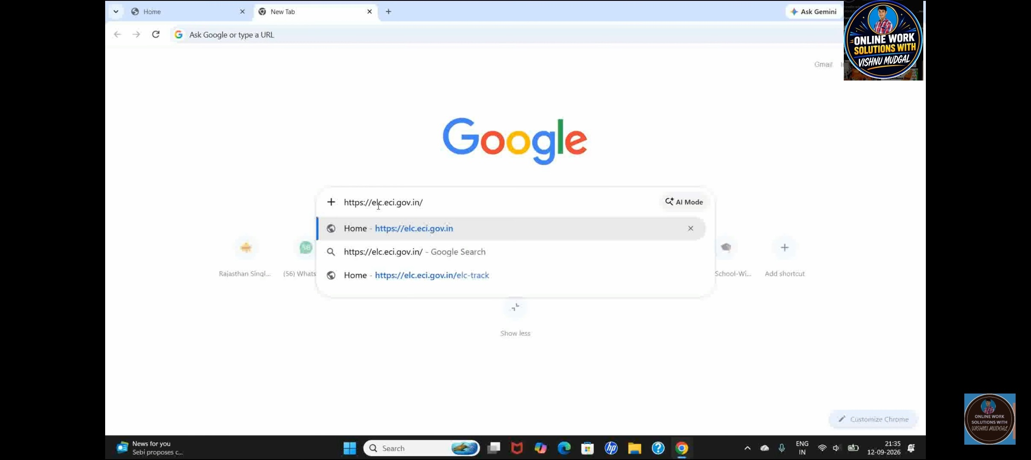

Slide 5
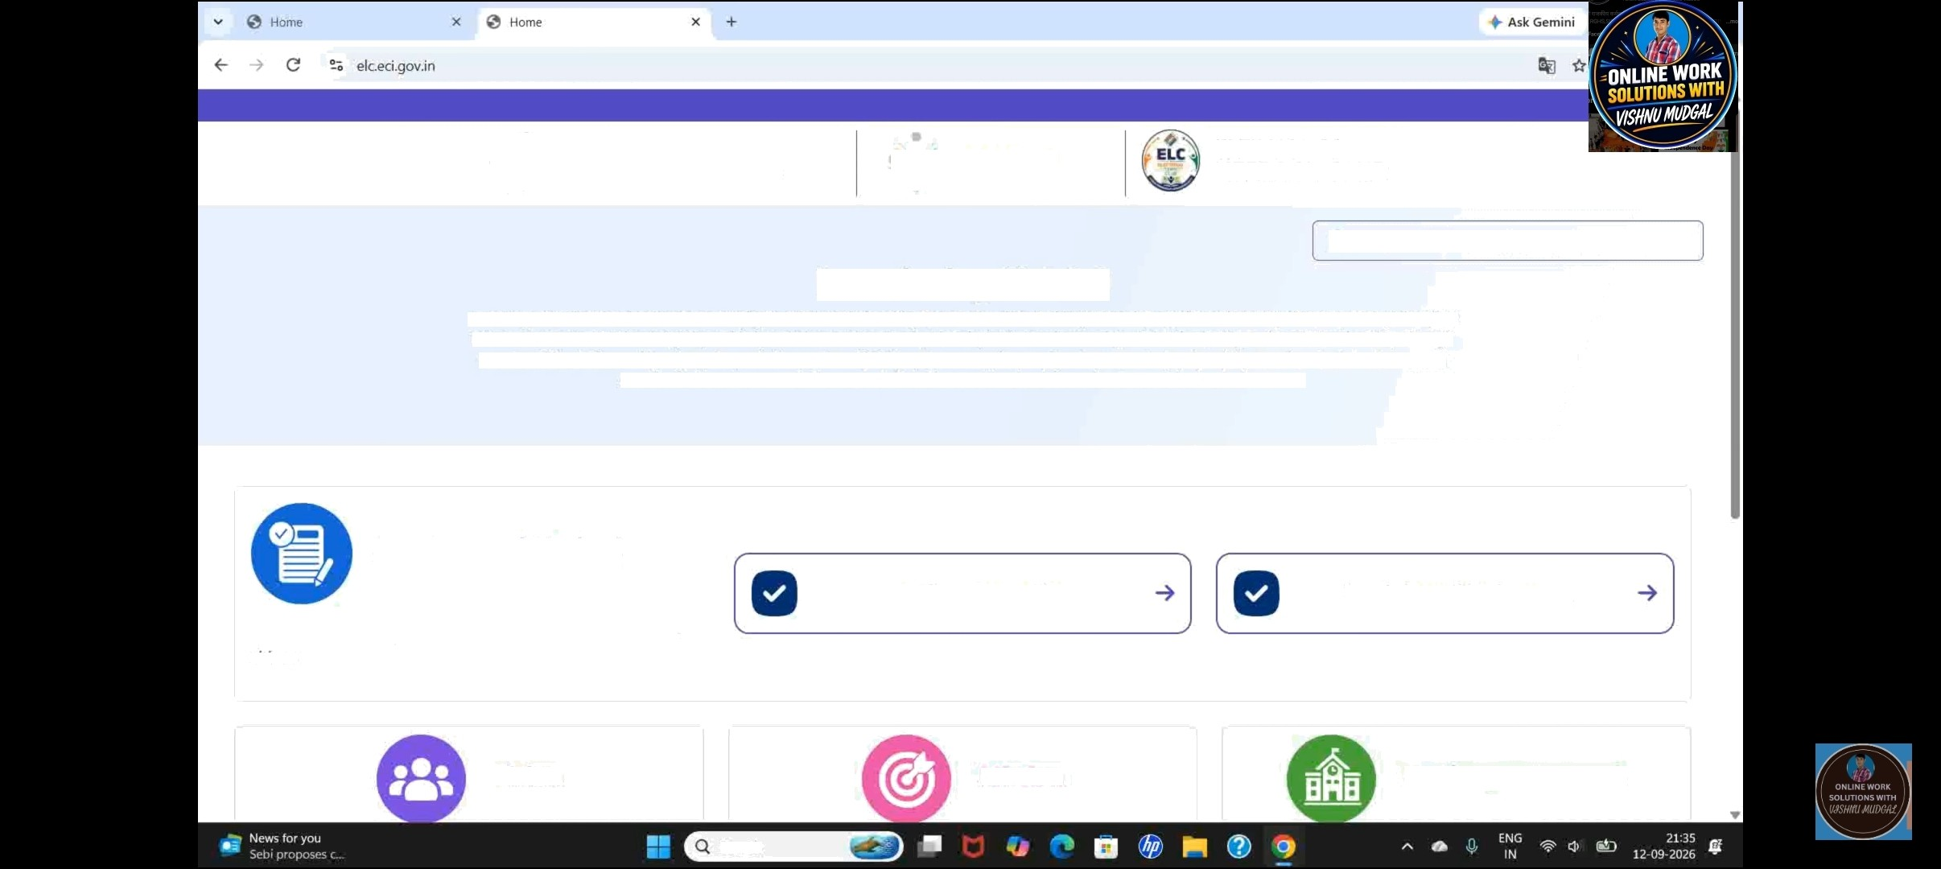


élection Commission of India
ECINET
ELECTORAL LITERACY CLUB
Are you a registered ELC ? Click here to login -3'
Introducing ELC 2.0
Over the years, educational institutions have pÏayed a vital role in fostering r}emocratic values. Building on this leqacy, Electoral Literacy Club 2.0 (ELC 2.0) reimaqines ELCs as a more structured and digitally enabîed youth democratic network. driven by institutianal ownership, student leadership, and contînuous leaming. Through engaging ELC activities and hands-on demonstration sessions, ELC 2.0 equips younp citizens with a deeper understanding of democratic and eîectoral promesses, provides first-hand exposure to the conduct of elections, and inspires informed, active participation in democracy.
Get Started Today!
Register Your ELC
Track Your ELC Request
Join the movement. join the club. Be an informed and active citizen
Vision
ÏSSÏOI1
Working Framework
Search

Slide 6
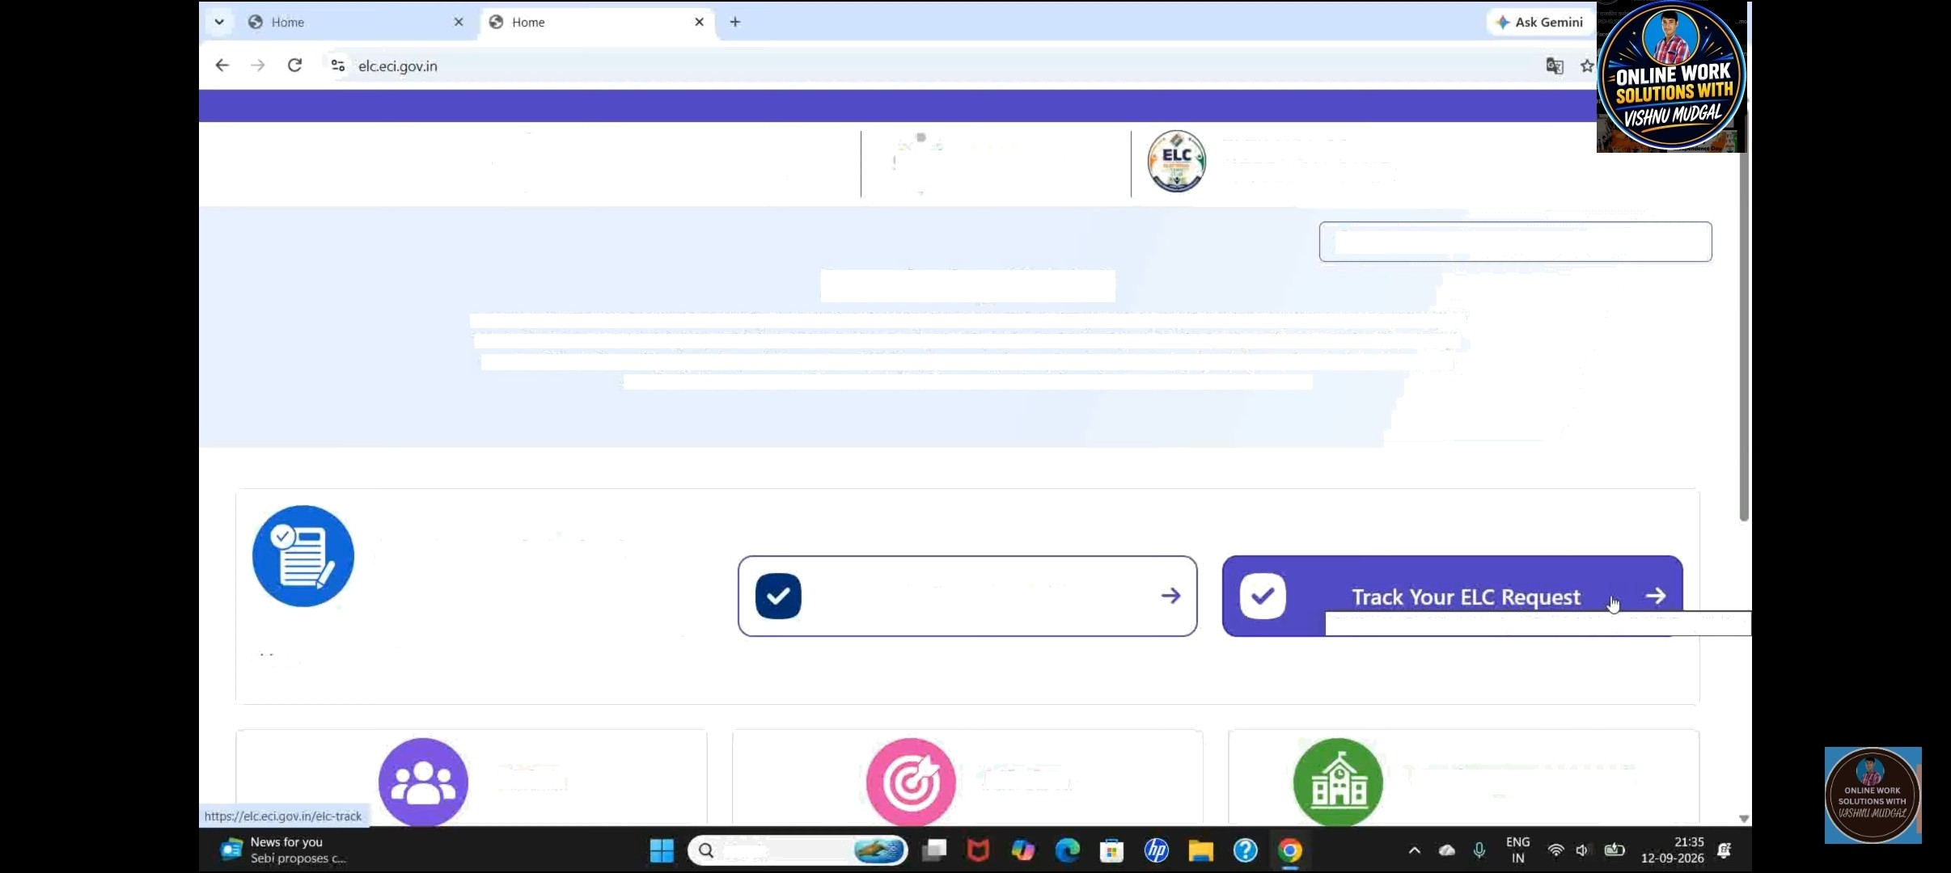


élection Commission of India
ECINET
ELECTORAL LITERACY CLUB
Are you a registered ELC ? Click here to login -3'
Introducing ELC 2.0
Over the years, educational institutions have pÏayed a vital role in fostering democratic values. Building on this leqacy, électoral Literacy Club 2.0 (ELC 2.0) reimaqines ELCs as a more structured and digitally enab\ed youth democratic network. driven by institutianal ownership, student leadership, and contînuous leaming. Through engaging ELC activities and hands-on demonstration sessions, ELC 2.0 equips younp citizens with a deeper understanding of democratic and eîectoral promesses, provides first-hand exposure to the conduct of elections, and inspires informed, active participation in democracy.
Get Started Today!
Register Your ELC
Join the movement. join the club. Be an informed and active citizen
Click here for Track the status of your Electoral LJteracy Club (ELC) application
VislOF\
Mission
Working Framework
Search

Slide 7
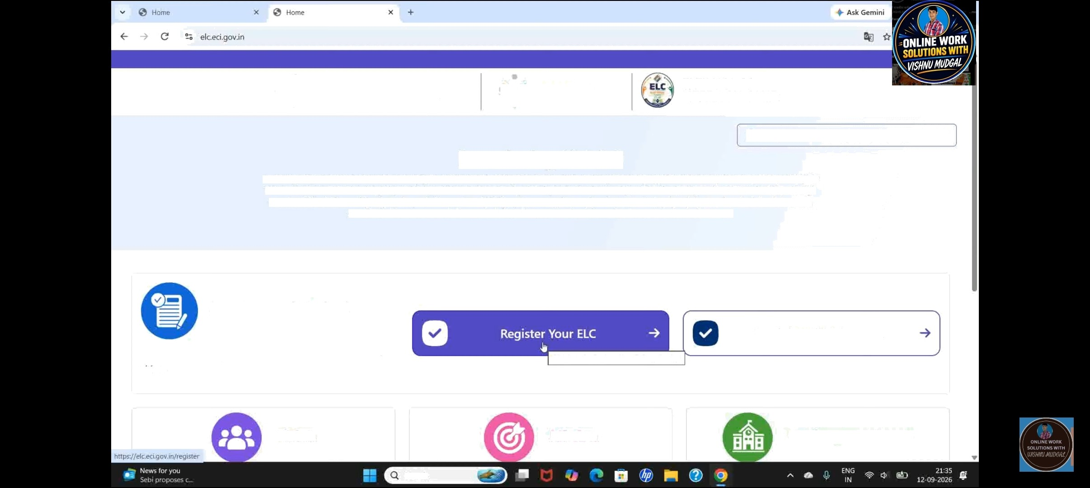


élection Commission of India
ECINET
ELECTORAL LITERACY CLUB
Are you a registered ELC ? Click here to login -3'
Introducing ELC 2.0
Over the years, educational institutions have pÏayed a vital role in fostering democratic values. Building on this leqacy, Electoral Literacy Club 2.0 (ELC 2.0) reimaqines ELCs as a more structured and digitally enab\ed youth democratic network. driven by institutianal ownership, student leadership, and contînuous leaming. Through engaging ELC activities and hands-on demonstration sessions, ELC 2.0 equips younp citizens with a deeper understanding of democratic and eîectoral promesses, provides first-hand exposure to the conduct of elections, and inspires informed, active participation in democracy.
Get Started Today!
Track Your ELC Request
Join the movement. join the club. Be an informed and active citizen
Click here for Reqister Your ELC application
VislOF\
Mission
Working Framework
Search

Slide 8



Election Commission of India
ECINET
ELECTORAL LITERACY CLUB
Are you a registered ELC ? Click here to login -g'
Introducing ELC 2.0
Over the years, educational institutions have played a vital role in fostering democratic values. Building on this legacy, Electoral Literacy Club 2.0 (ELC 2.0) reimaqines ELCs as a more structured and digitally enabled youth democratic network. driven by institutional ownership, student leadership, and continuous learning. Through engaging ELC activities and hands-on demonstration sessions, ELC 2.0 equips younp citizens with a deeper understanding of democratic and electoral processes, provides first-hand exposure to the conduct of elections, and inspires informed, active participation in democracy.
Get Started Today!
Register Your ELC
Join the movement. join the club. Be an informed and active citizen
Click here for Track the status of your Electoral Literacy Club (ELC) application
Vision
Mission
Working Framework
Search

Slide 9
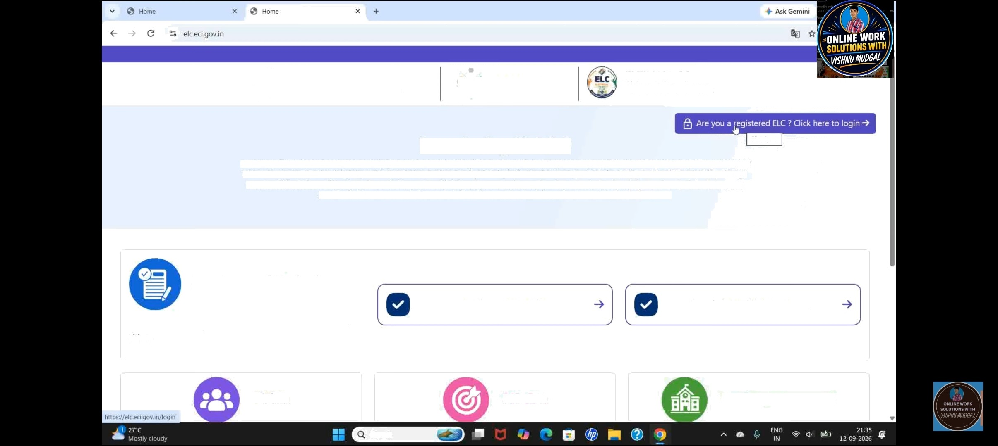


Election Commission of India
ECINET
ELECTORAL LITERACY CLUB
Introducing ELC 2.0
Over the years, educational institutions have played a vital role in fostering democratic values. Building on this legacy, Electoral Literacy Club 2.0 (ELC 2.0) reimaqines ELCs as a more structured and digitally enabled youth democratic network. driven by institutional ownership, student leadership, and continuous learning. Through engaging £LC activities and hands-on demonstration sessions, ELC 2.0 equips younp citizens with a deeper understanding of democratic and electoral processes, provides first-hand exposure to the conduct of elections, and inspires informed, active participation in democracy.
Click here
Get Started Today!
Register Your ELC
Track Your ELC Request
Join the movement. join the club. Be an informed and active citizen
Vision
Mission
Working Framework
Search

Slide 10
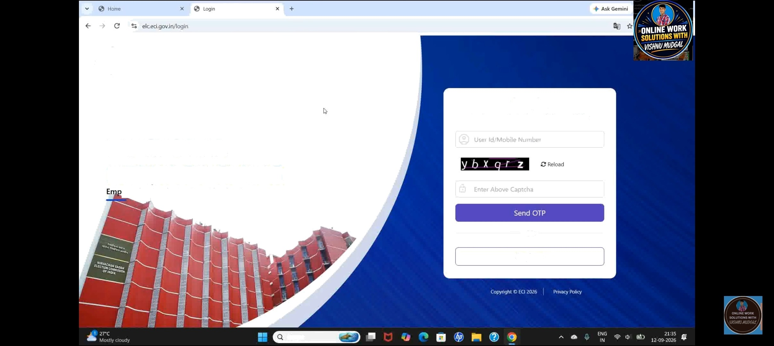
"x ^ Election Commission of India
Log In
Login to continue Electoral Literacy Clubs
ELECTORAL
LITERACY CLUBS
owering Students. Strengthening Democracy
OR
Register
Search

Slide 11
ELECTORAL LITERACY CLUBS
owering Students. Strengthening Democracy
Election Commission of india
OTP Verification !
Note OTP is valid for 2 minutes only.

Slide 12
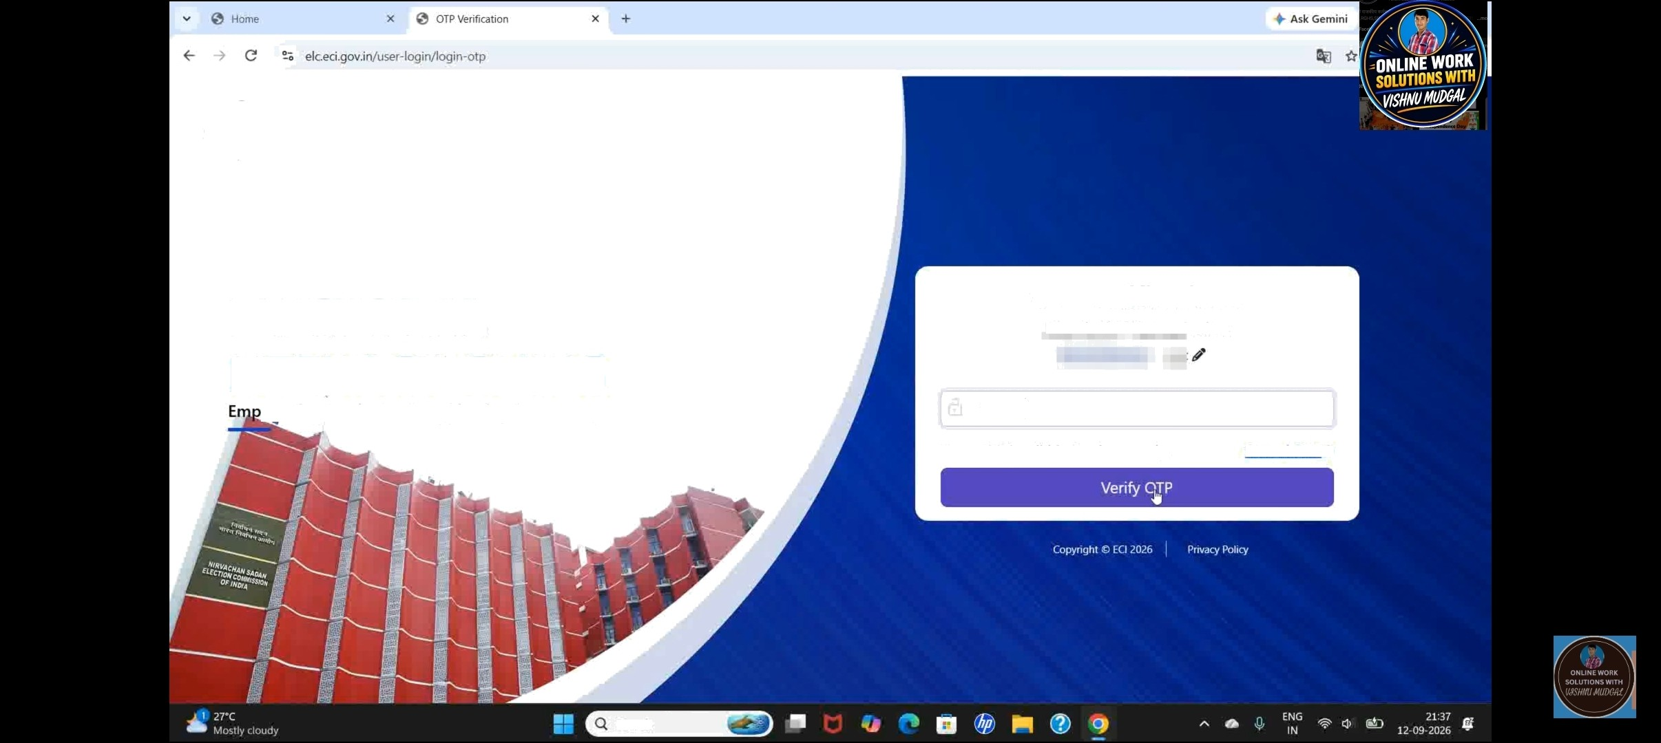
”’x
" Election Commission of India
ELECTORAL
LITERACY CLUBS
owering Students. Strengthening Democracy
OTP Verification !
Fnter the FTP Ynt received on
16582D
Note : OTP is valid for 2 minutes only.
Resend OTP -3'
Search

Slide 13
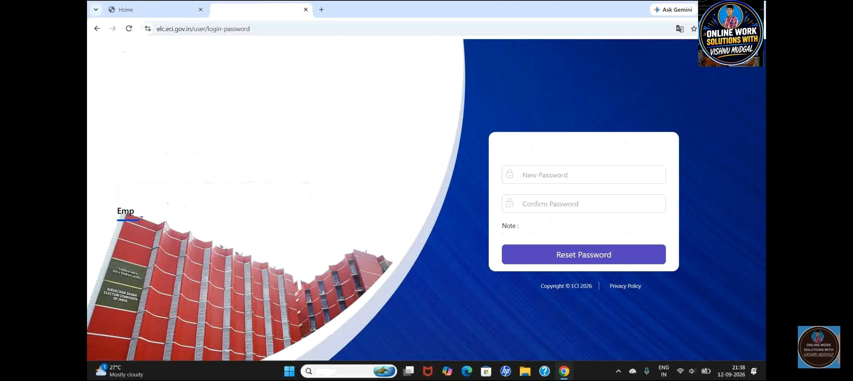
Reset Password
”’x ^ Election Commission of India
ELECTORAL
LITERACY CLUBS
owering Students. Strengthening Democracy
Reset Password !
At least 8 characters, one uppercase letter, one lowercase letter, one number and one special character.
Search

Slide 14
Profile Incomplete
Please update the following details/documents from Update
Lottnr Of AutŁłorlzofion

Slide 15
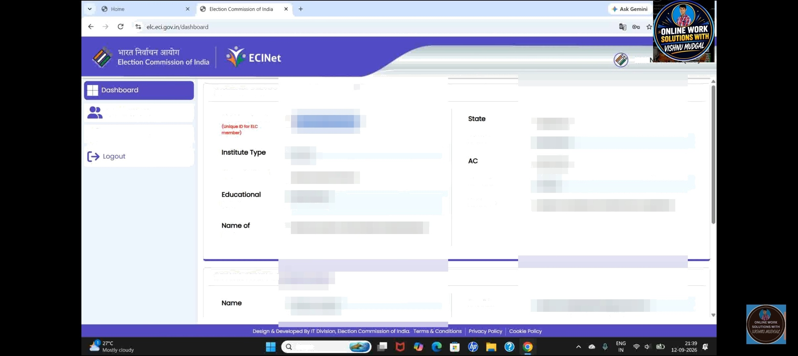


VISH
INSTITUTE DETAILS
ELC fvJembers
ELC Member ID
Update Profile
Type of School
Plncode
Board
Address
Institute
DETAILS OF HEAD I
Search

Slide 16
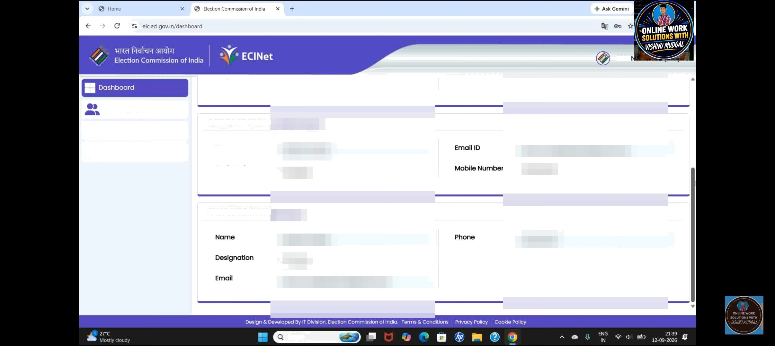
VISH
Institute
ELC fvJembers
Update Profile
DETAILS OF HEAD I
Logout
NOme
Designation
ELC COORDINATOI
Search

Slide 17
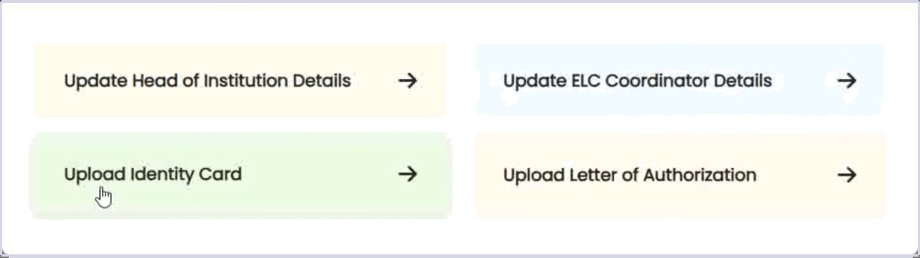
Select what you wont to Update

Slide 18

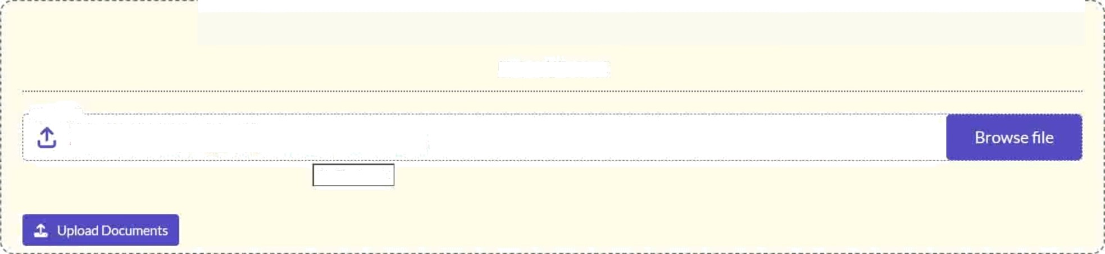


VIS
Dashboard
Updote Proflle
ELC Members
Update Prohle
Upload IDCard
Logout
ID Card
Upload the supporting document
’Suppor ted formats only .pdf y,jpg ,’.png /jpe,° .’ Fi s1ze must be less than SMB
No file chosen

Slide 19



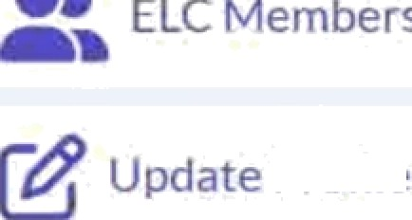
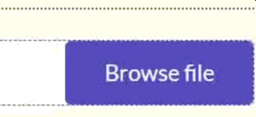









VIS
Updote Profile
Upload ID Card
rCrtif1cate.o‹1f

Slide 20



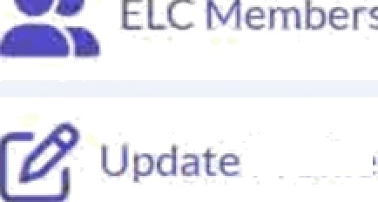
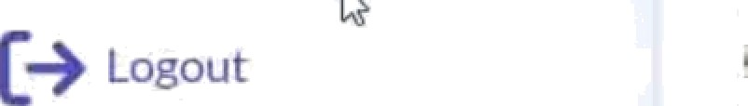
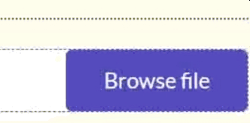


VIS
Updote Profile
Upload ID Card

Slide 21





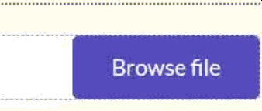

VIS
Updote Profile
Upload ID Card
ID Cai ‹I

Slide 22
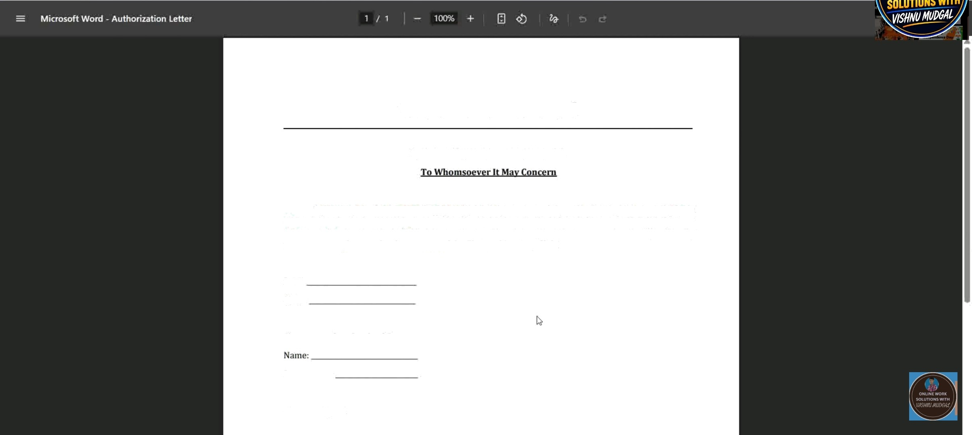
Institute LeGer Head
Letter ofAutbortza¢iox / Request
1, [Nnme ofAuthorized Permit}, }Designatioit}, have been duly authorized by the Head of[Name of Institution) to submit the application for the establishment of an Electoral Literacy Club (ELC) in our educational institution. On behalf of the institution. 1 hereby request the concerned authority to kindly process our application for the creation of the E)ectoral Literacy Club.
Date:
Place:
Signature of Authorized Person
Designation:
Countersigned

Slide 23
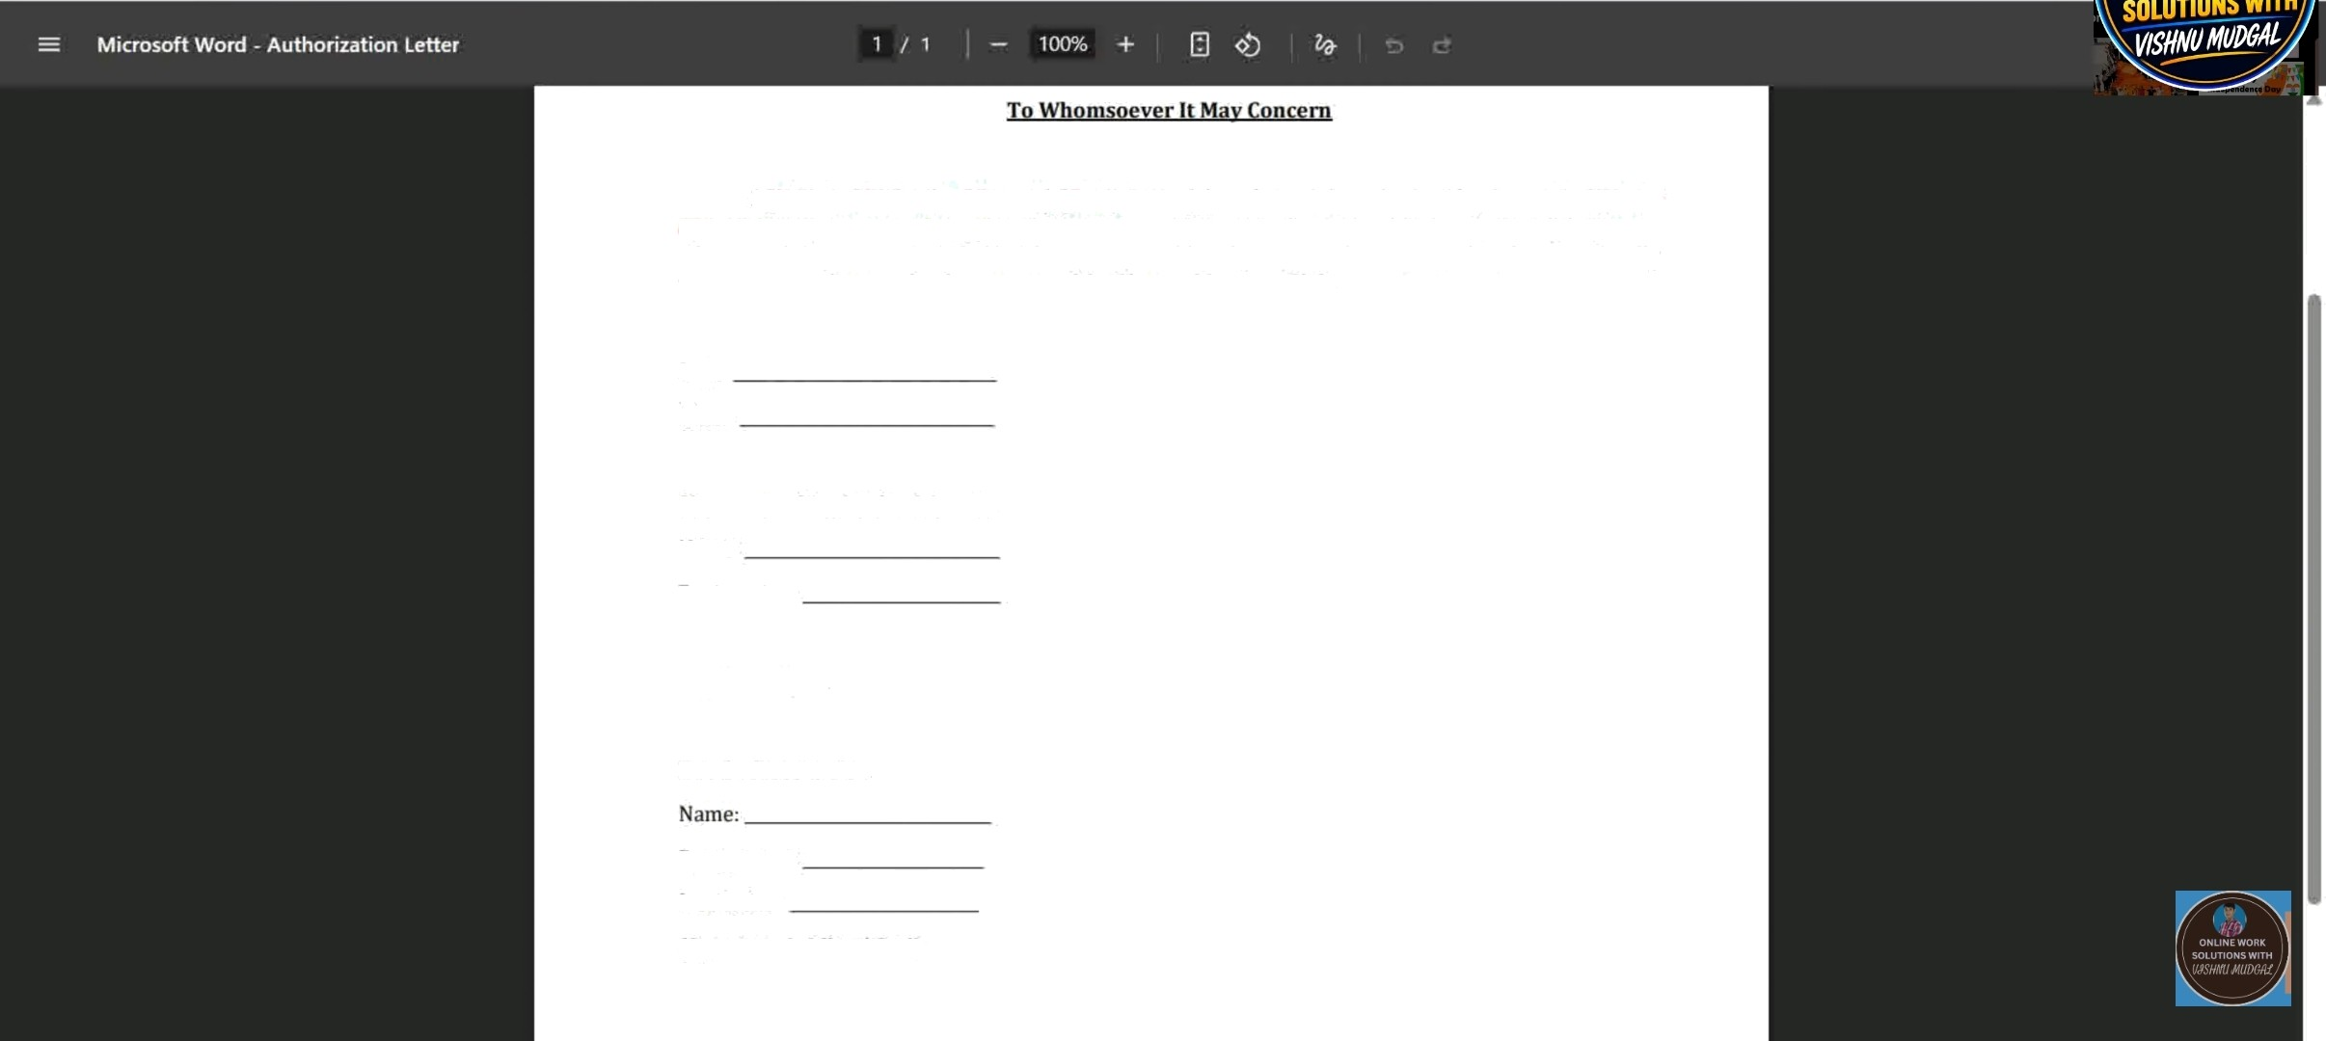
1, [Nome ofAiitttorized Persoit \, \Desi,qnatioit , have been duly authorized by the Head of \Noute of Iiistitutioit} to submit the application for the establishment of an Electoral Liter acy Club (ELC) in our educational institution. On behalf of the institution, 1 hereby request the concerned authority to kindly process our application ior the creation of the Electoral Literacy Club.
Date:
Place:
Signature of Authorized Person
Name: Designation:
Countersigned
Head of Institution
Designation:
Institution:
(Signature & Official Seal)

Slide 24





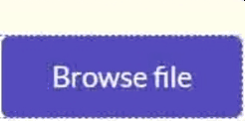

VIS
■■
Updoye Profile
Upload Letter of Authorization
Lettei of Authot izatiois
U0loarl the s ›Ppoi ting document

Slide 25






VISH
Dashboard
Ust Of ELC Members
Update Profile
Logout
No data available in table

Slide 26





VISH
Dashboard
Ust Of ELC Members
Update Profile
Logout
No data available in table

Slide 27

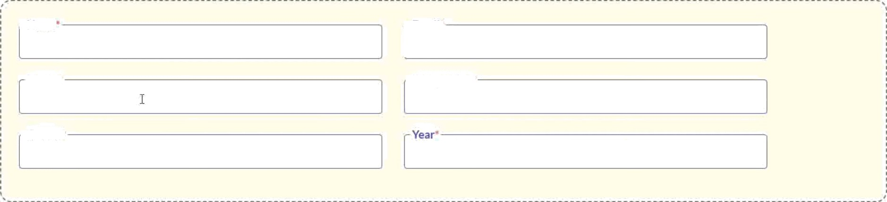

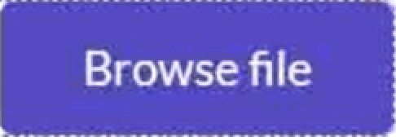

VIS
Dashboard
Add New Member
€• BOck
ELC Members
Name
Email‘
Update Profile
Lo8out
Phone*
-Designation’
- Course’
Upload the supporting document
”Supported formats only.pdf /.jpg /png/.|peg / File size njust be less than SMB

